Slide 1


OMNI-DIRECTIONAL ROBOT
Submitted for partial fulfillment of the requirement for the degree of
BACHELOR OF TECHNOLOGY
in
Electrical Engineering
By
SACHIN SHAKYA (Roll no-1907350200048)
ADITYA KUMAR (Roll no-1907350200005)
UPDESH PANDEY (Roll no-1907350200062)
SHIVBODH PAL (Roll no-1907350200053)
under the supervision of
Mr. Anuj Kumar, Assistant Professor
(Department of Electrical Engineering)
Rajkiya Engineering College Chandpur, Bijnor
Dr. A. P. J. ABDUL KALAM TECHNICAL UNIVERSITY
LUCKNOW, UTTAR PRADESH

Slide 2

WHY OMNI-DIRECTIONAL ROBOT ?
Movement in tight areas and to avoid obstacles.
Conventional vehicles do not have capability to control every degree of freedom.
In disaster zones, where the ability to move in any direction can be critical.
This is where our project comes into the picture to solve these problems. The robot has full Omni-directional motion capabilities in 2D.

Slide 3
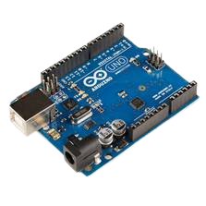
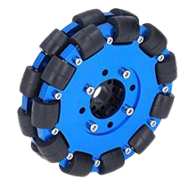
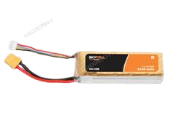
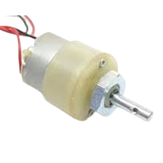
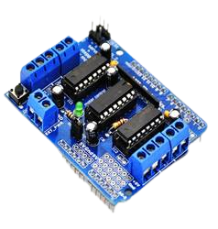
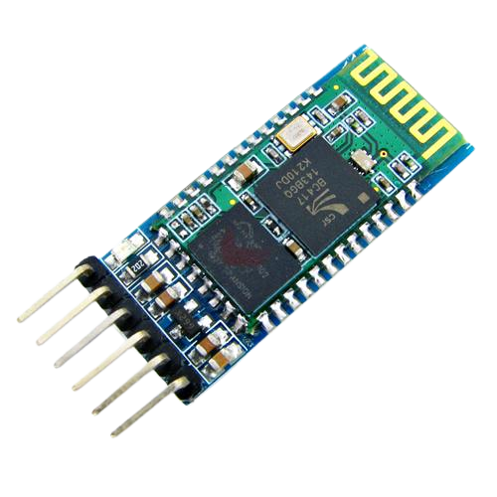

COMPONENTS
Arduino UNO R3
Omni-directional Wheels
12V Li-Po Battery
12V DC Gear motor
L293D Motor Driver Shield
HCO5 Bluetooth module

Slide 4
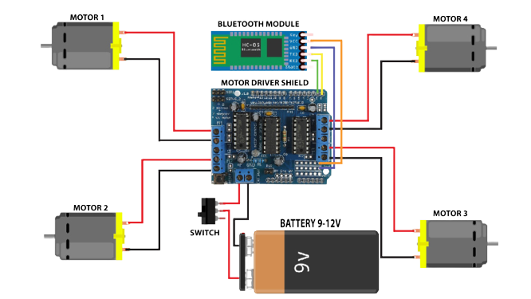
CIRCUIT DIAGRAM
fig.no.01

Slide 5
WORKING
Arduino drives all four motors using L293D Motor Driver Chips.
The robot movements depend on the software program downloaded into the Arduino board microcontroller, ATMega2560. The circuit and the robot’s complete working and operation are as per the software program.
When the Arduino board gets a command from the Transmitter,
It will rotate all four motors forward or reverse as per the requirement to move the robot in the desired direction.
Transmitter gets a command from the user’s Receiver.
It then sends this command to the Arduino board serially using Tx and Rx pins.

Slide 6
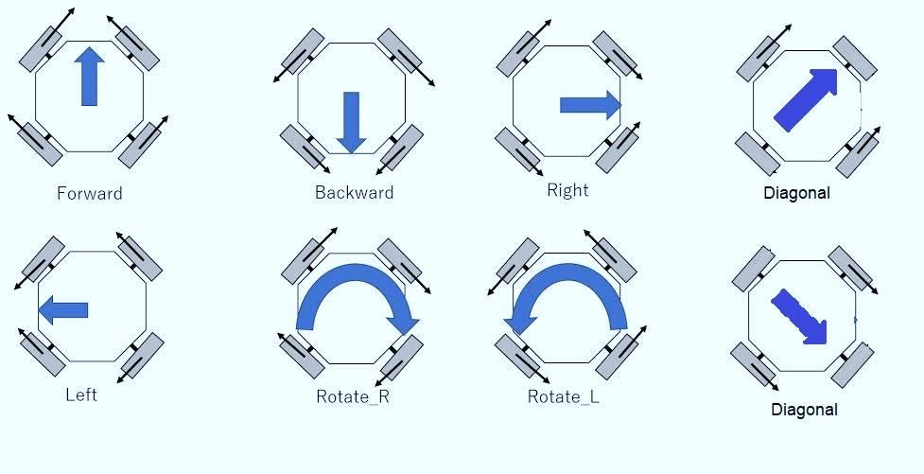
WORKING MECHANISM
fig.no.02

Slide 7
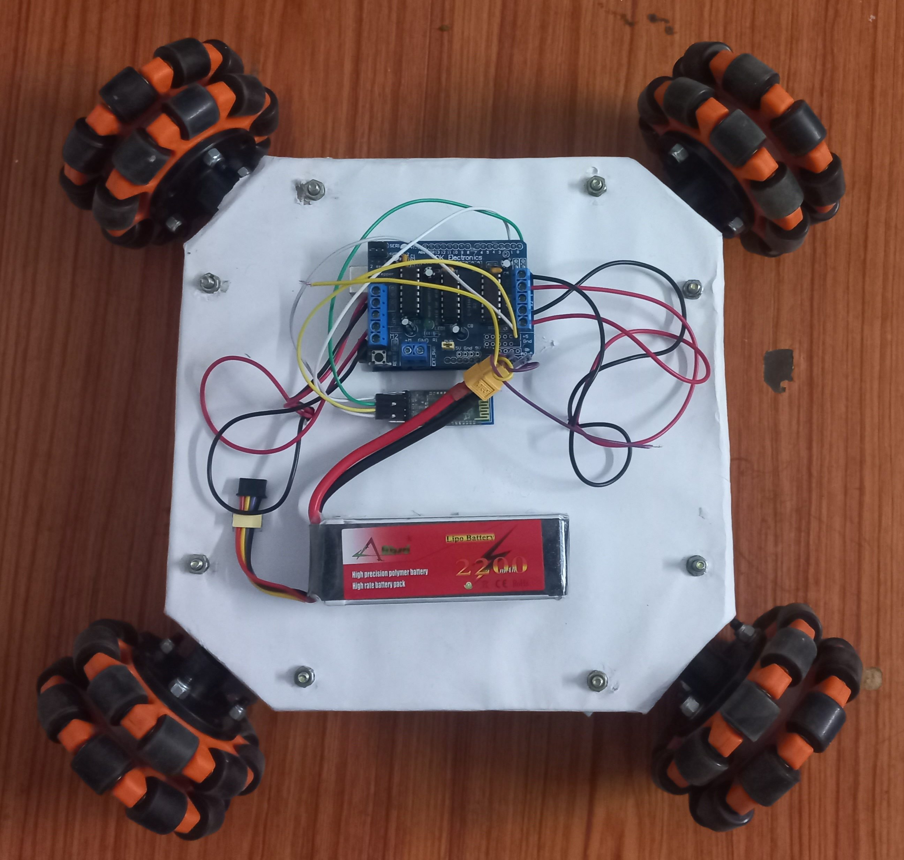
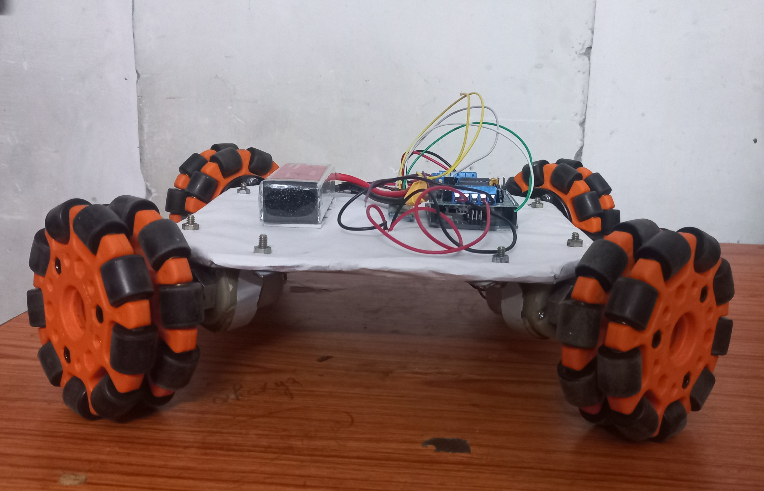
HARDWARE
Fig. no. 03
Fig. no. 04

Slide 8
ADVANTAGES
Quick installation and removal
Omni-directional mobility
Space saving technology
Highly adaptable

Slide 9
LIMITATIONS
Limited Payload
Cost & Suspension
Computationally Complex

Slide 10
APPLICATIONS
Complex Trajectories
Warehouse Automation
Flexible material handling
Hospitality and Narrow Aisles
Manufacturing and Security

Slide 11

FUTURE SCOPE
In the near future work, Omni wheeled robots can be designed using a hydraulic piston that gives the robot extra power to perform mechanical work in the field.
Robot wheels can be further developed to navigate winding and sloping terrain.
These types of robots are used in the military, in industries for forklifts, in electric cars, ambulances and various other applications.
As technology continues to develop, omnidirectional vehicles will become more efficient, affordable, and reliable.

Slide 12
REFERENCES
Arduino IDE Software
https://www.arduino.cc/en/software
Development of an omnidirectional Automated Guided Vehicle https://www.sciencedirect.com/science/article/pii/S2213020915001068
Omnidirectional mobile robots, mechanisms https://www.sciencedirect.com/science/article/abs/pii/S0094114X2030179
Chui, C. K., & Ang Jr, M. H. (2004). Design and development of an omnidirectional robot. Robotics and Autonomous Systems, 48(3), 171-181.

Slide 13


